Slide 1


Slide 2
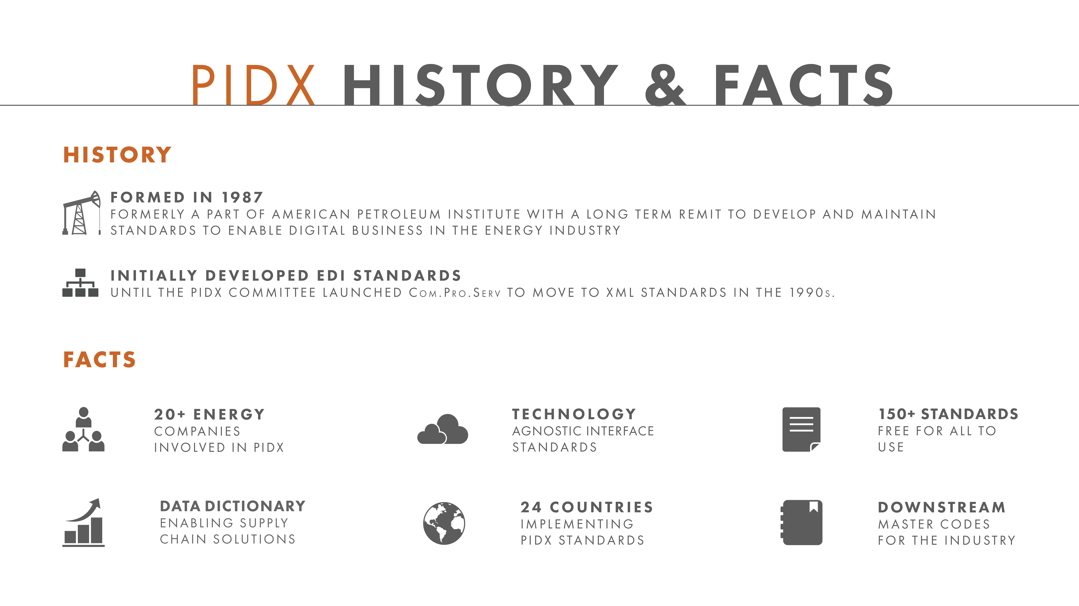

Slide 3
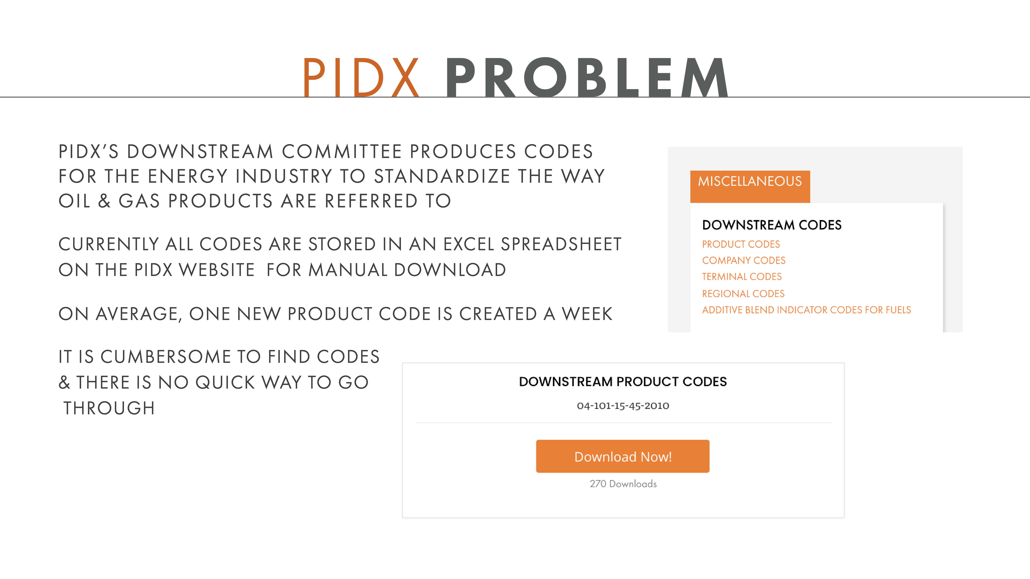

Slide 4
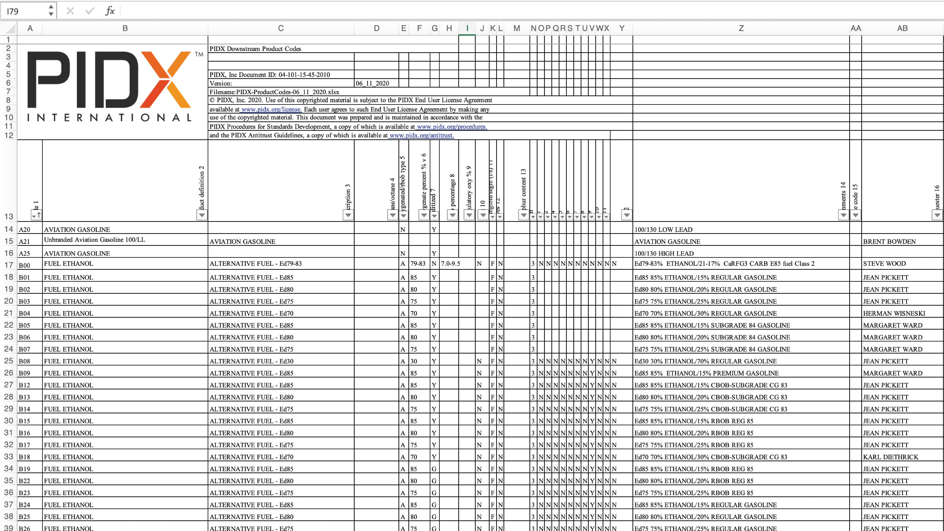

Slide 5
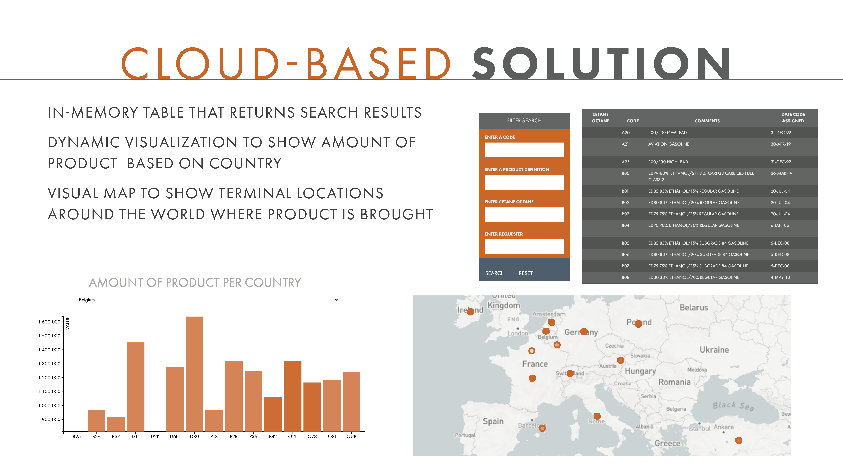

Slide 6
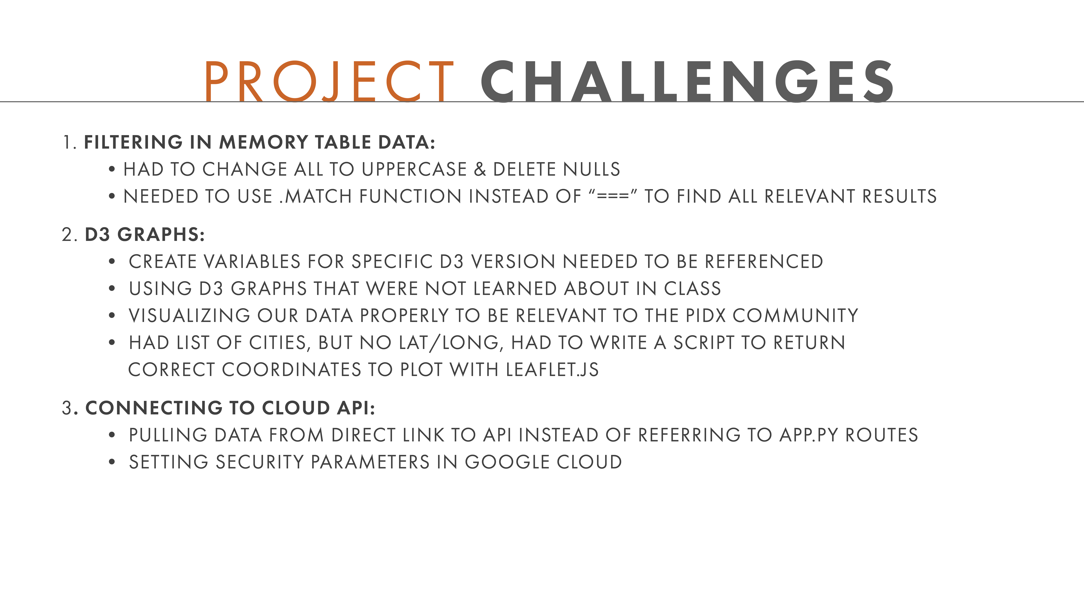
PIDX Product Codes Web Service (PCS) – Support End Users with Web Page Search Interface to APIs
PIDX Web Server
PIDX Web Server
Web Browser
Web Page Request
PHP Web Interface
Web API Requests
API Handler Interfaces
Requests
DB Query Interfaces
API Responses
Responses
User navigates to PIDX PHP Web Page
User enters a product code to search for on Web Page (Example “AO1”)
PHP Calls API Handler which decodes request and calls the DB Query Handler with the Product Code
DB Query Interfaces Selects Product Code Data based on passed Product Code
SQL Returns all data to DB Query Handler for that Product Code or a “Not Found Error”
DB Query formats the response into a JSON package and passes to the API Handler
API Handler responds to calling programs API Interface with JSON package with Product Code Details or “Not Found Error”
PHP Interface formats response as HTML page and serves to web browser
Query Results
Queries
Manual Interface
Product Codes MySQL DB

